Slide 1
Using Fijiwings2.1 to study cell growth
Shipman and Dobens, GSA PREP

Slide 2
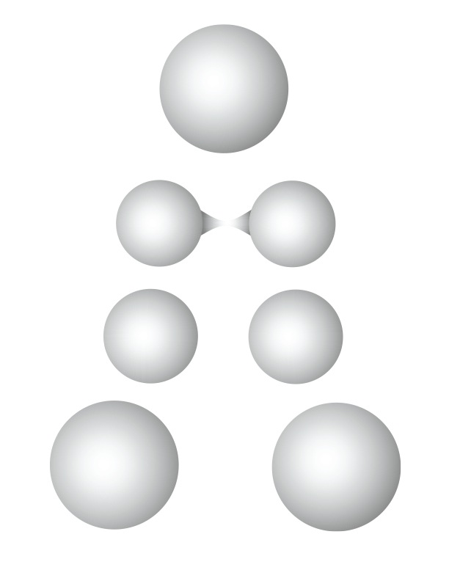

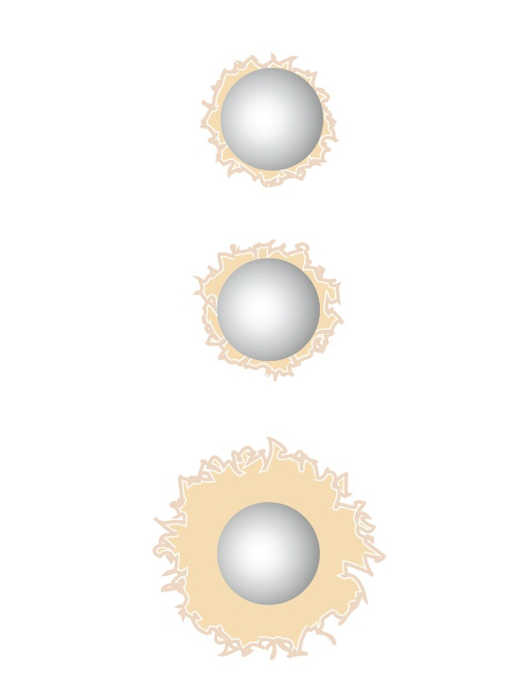
Tissue Growth
Increase in cell number, size or extracellular matrix (often swells to absorb water)
proliferation
growth
matrix production
Dobens, unpublished

Slide 3
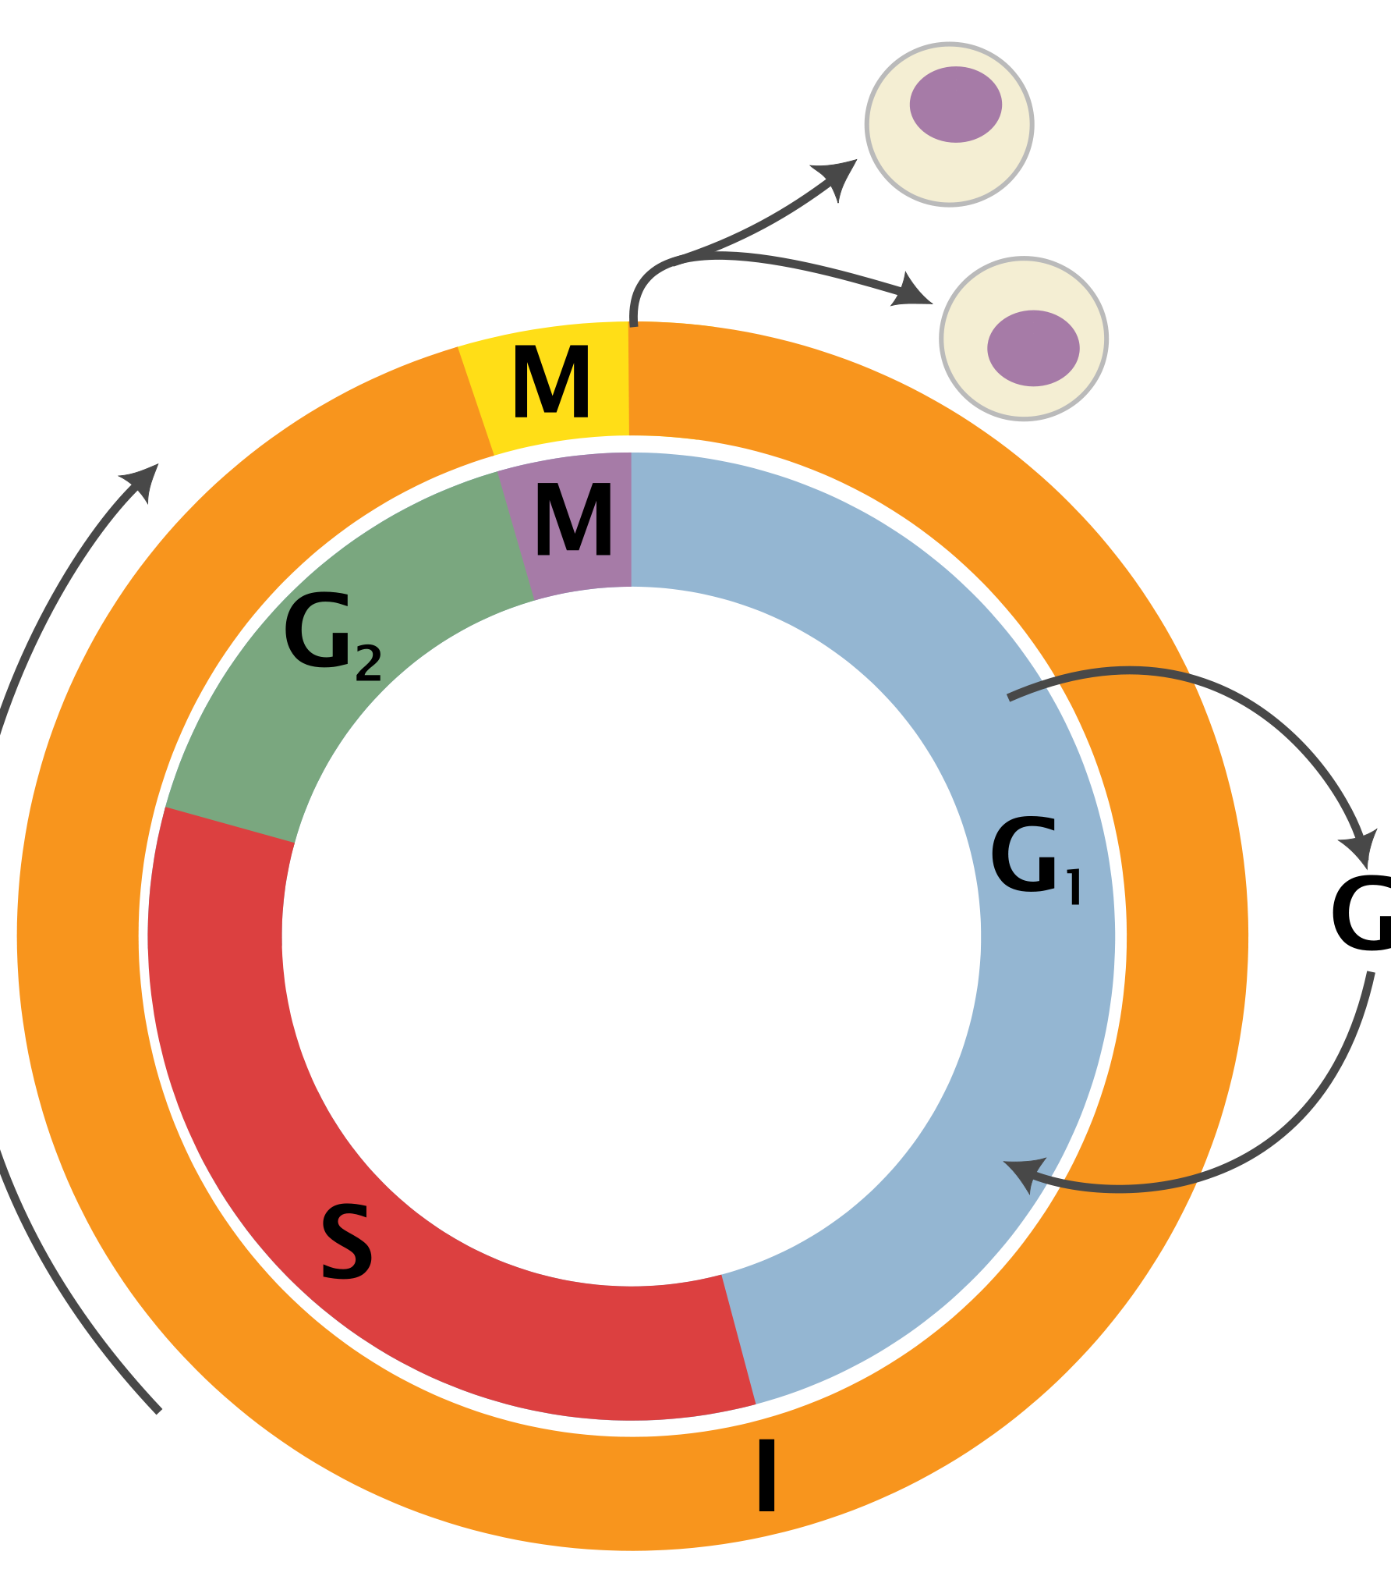
Cell cycle
https://en.wikipedia.org/wiki/Cell_cycle#/media/File:Cell_Cycle_2-2.svg

Slide 4
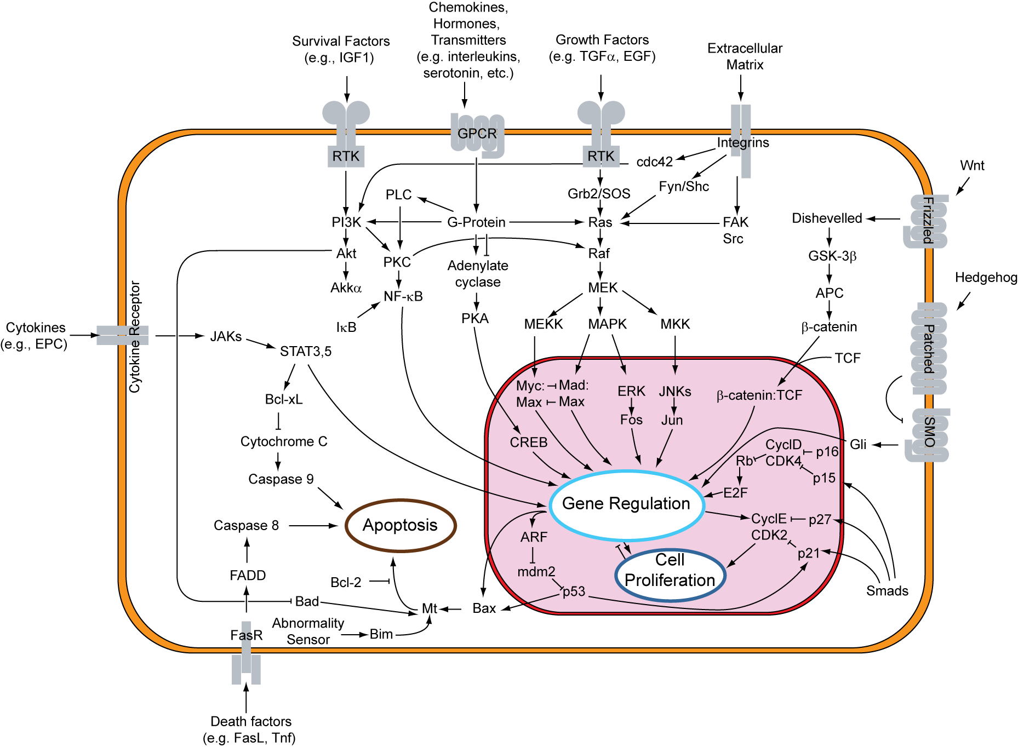
Regulation of the cell cycle
https://en.wikipedia.org/wiki/Cell_cycle#/media/File:Signal_transduction_pathways.svg

Slide 5
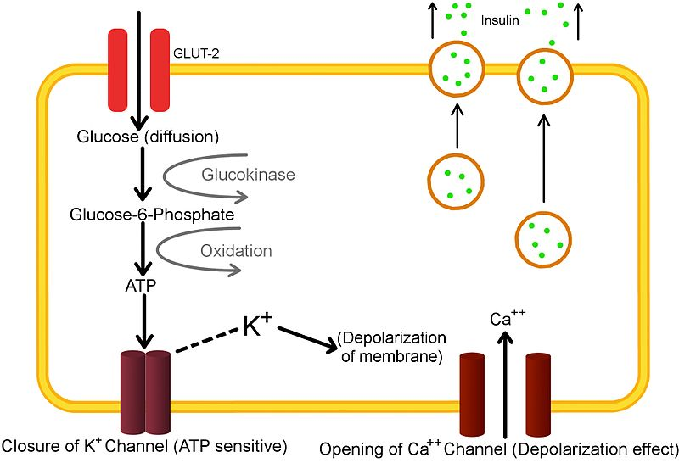
Intrinsic and extrinsic signals control growth
Flies get big as larva, depending on whether well-fed
Cell measures ATP content via TOR signaling pathway
Organism uses widespread growth factors and hormones to regulate cell size and cell proliferation: Insulin-like growth factor
https://en.wikipedia.org/wiki/File:2nd_bio_diagram_2.jpg

Slide 6
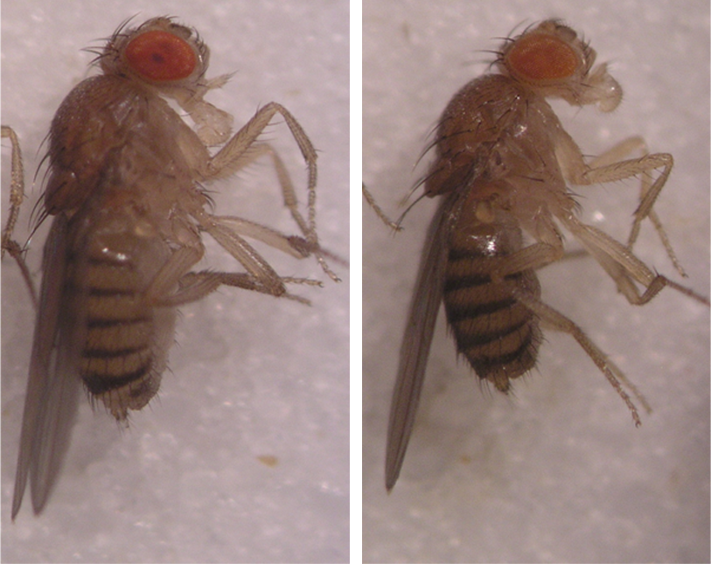
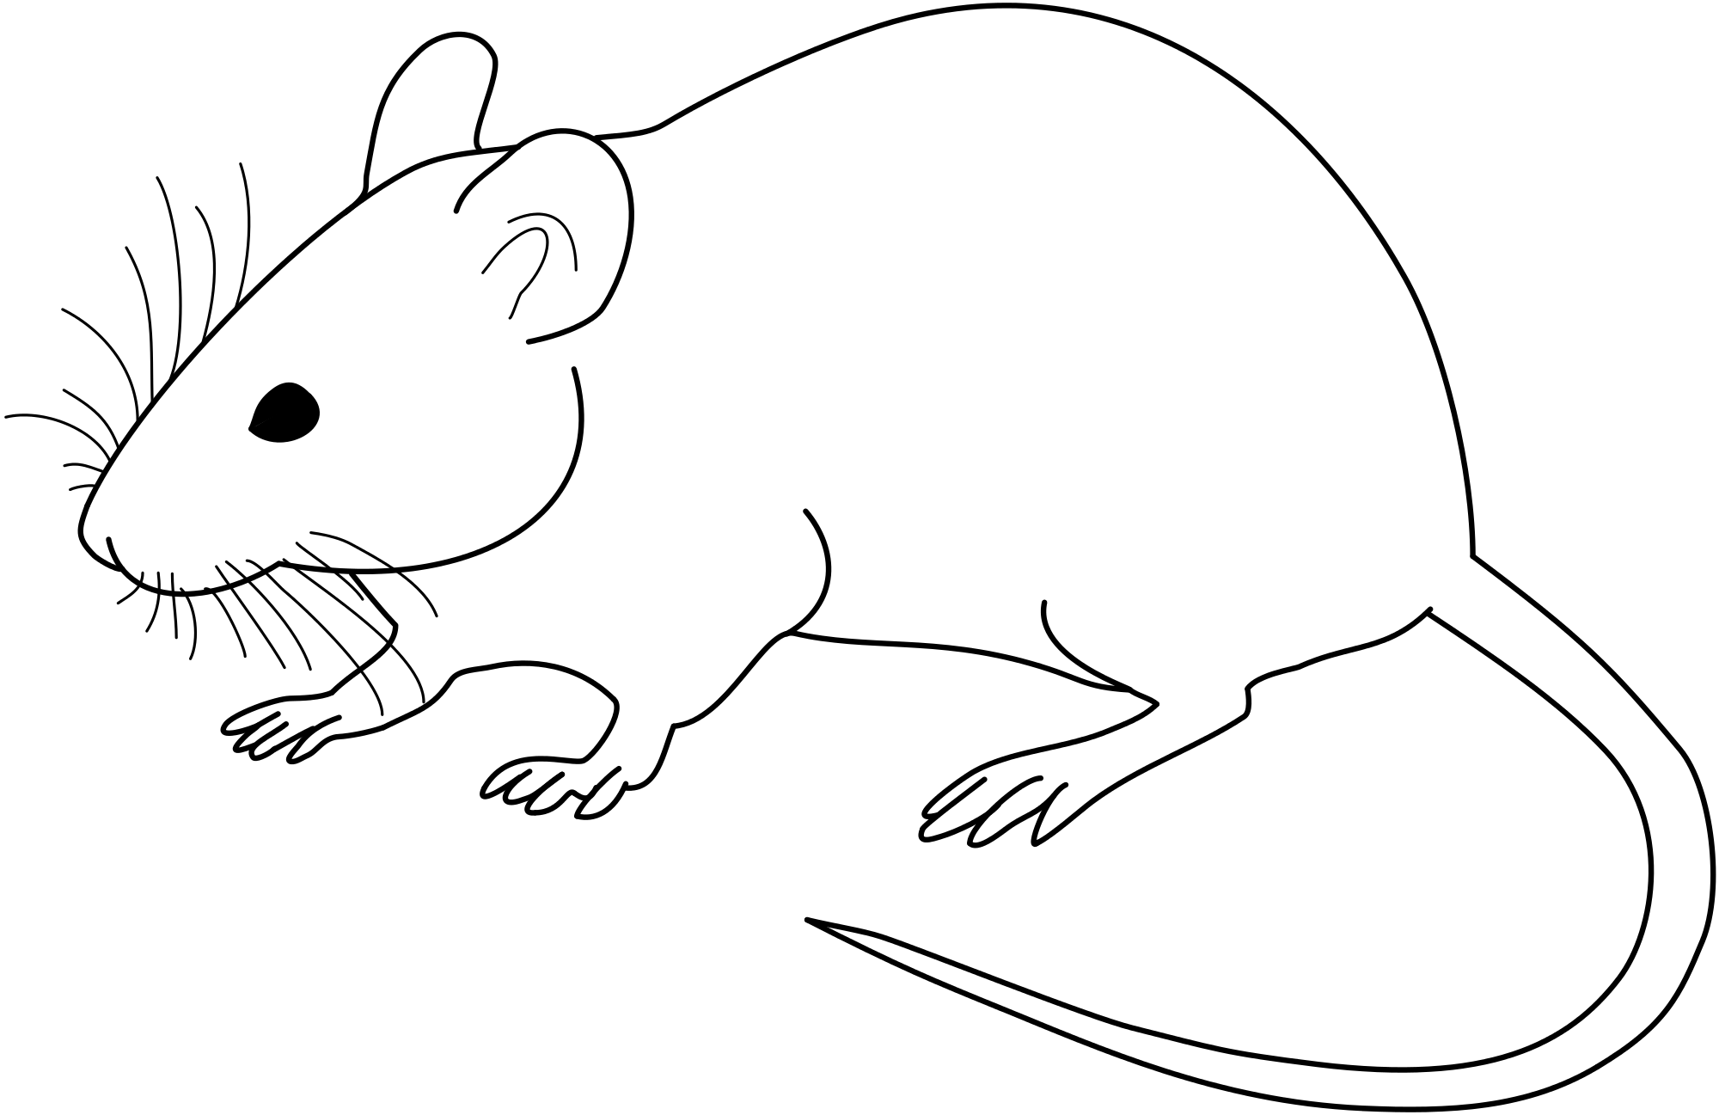
Insulin signaling required for animal growth
Reduction of insulin signaling in fly
Reduction of insulin signaling in mouse
Normal mouse
Fat body
cells
Dwarf mouse
WT fly
Trbl-expressing
fly
Dobens, unpublished

Slide 7
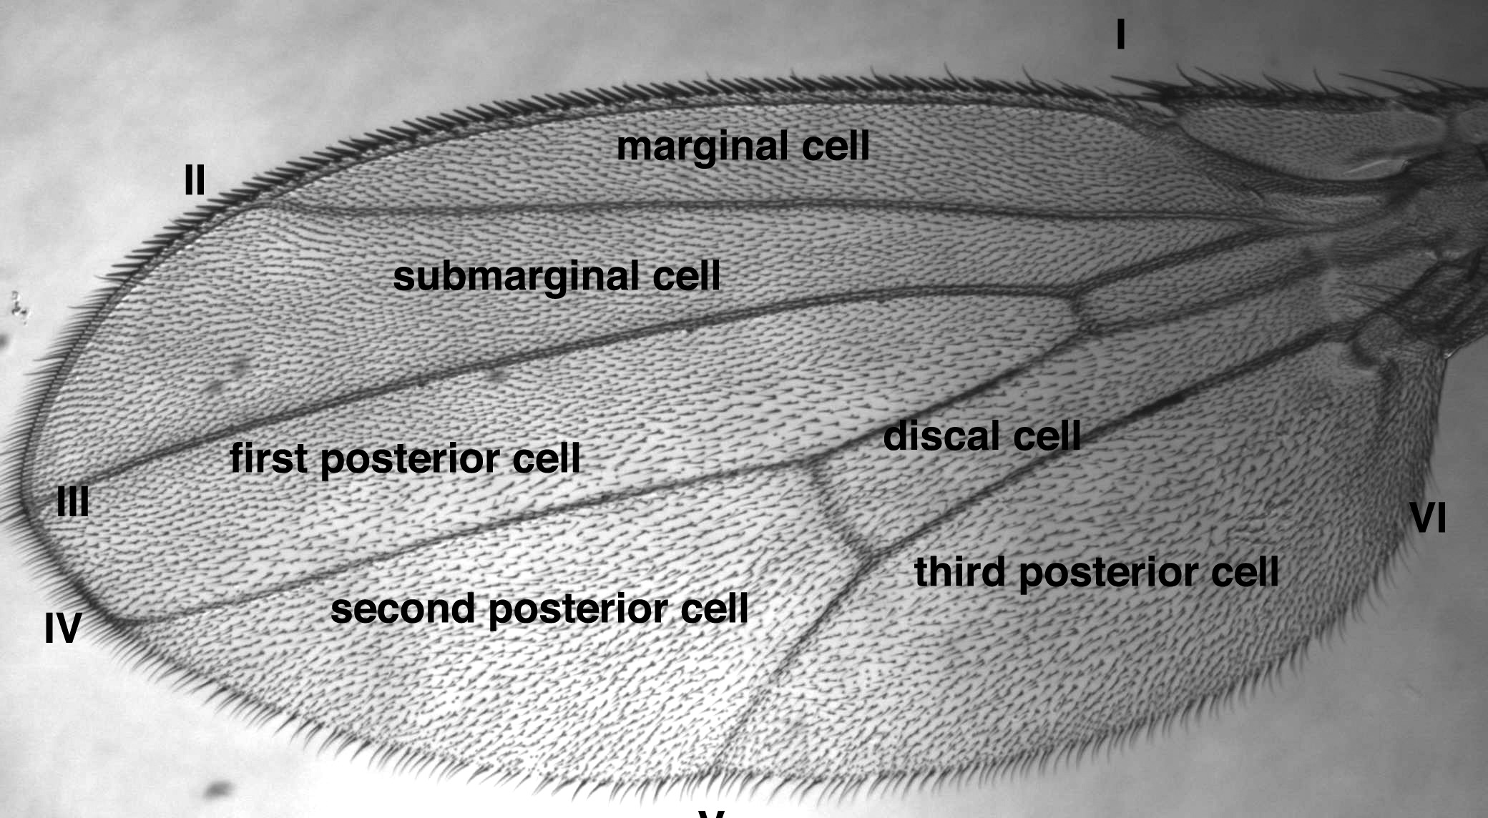
Identifying intervein regions
Dobens, unpublished

Slide 8
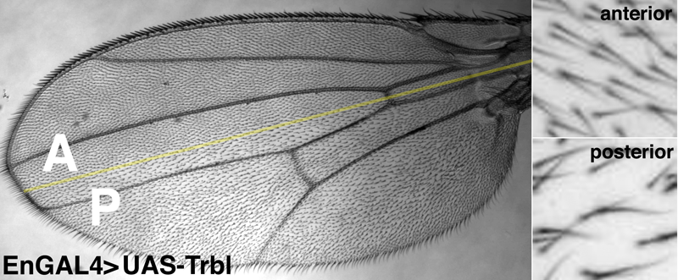
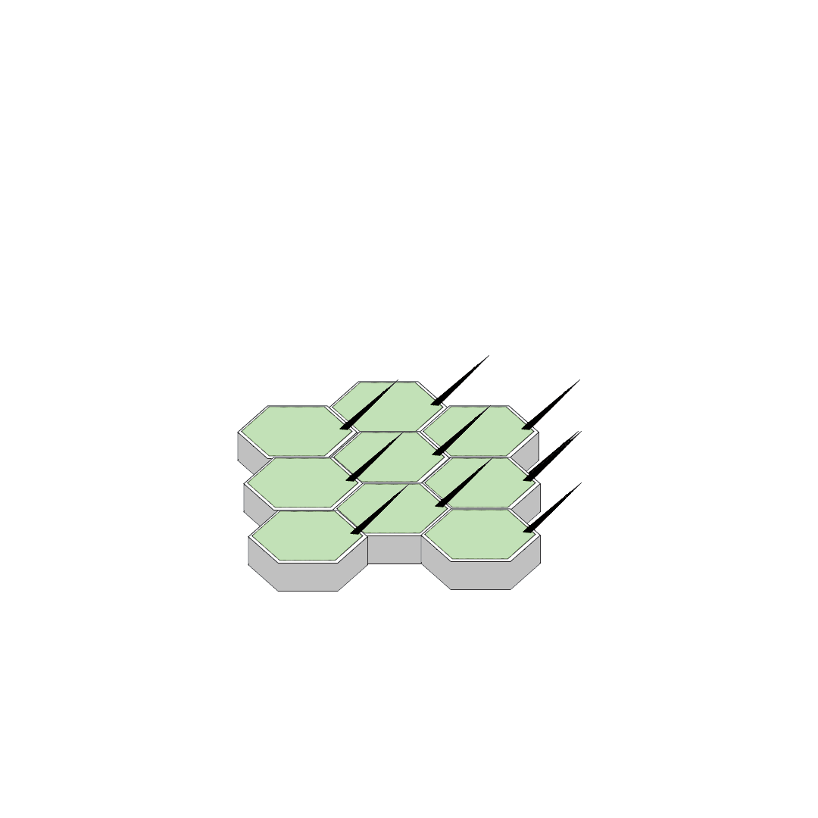
Trbl misexpression in the wing
Dobens, unpublished

Slide 9
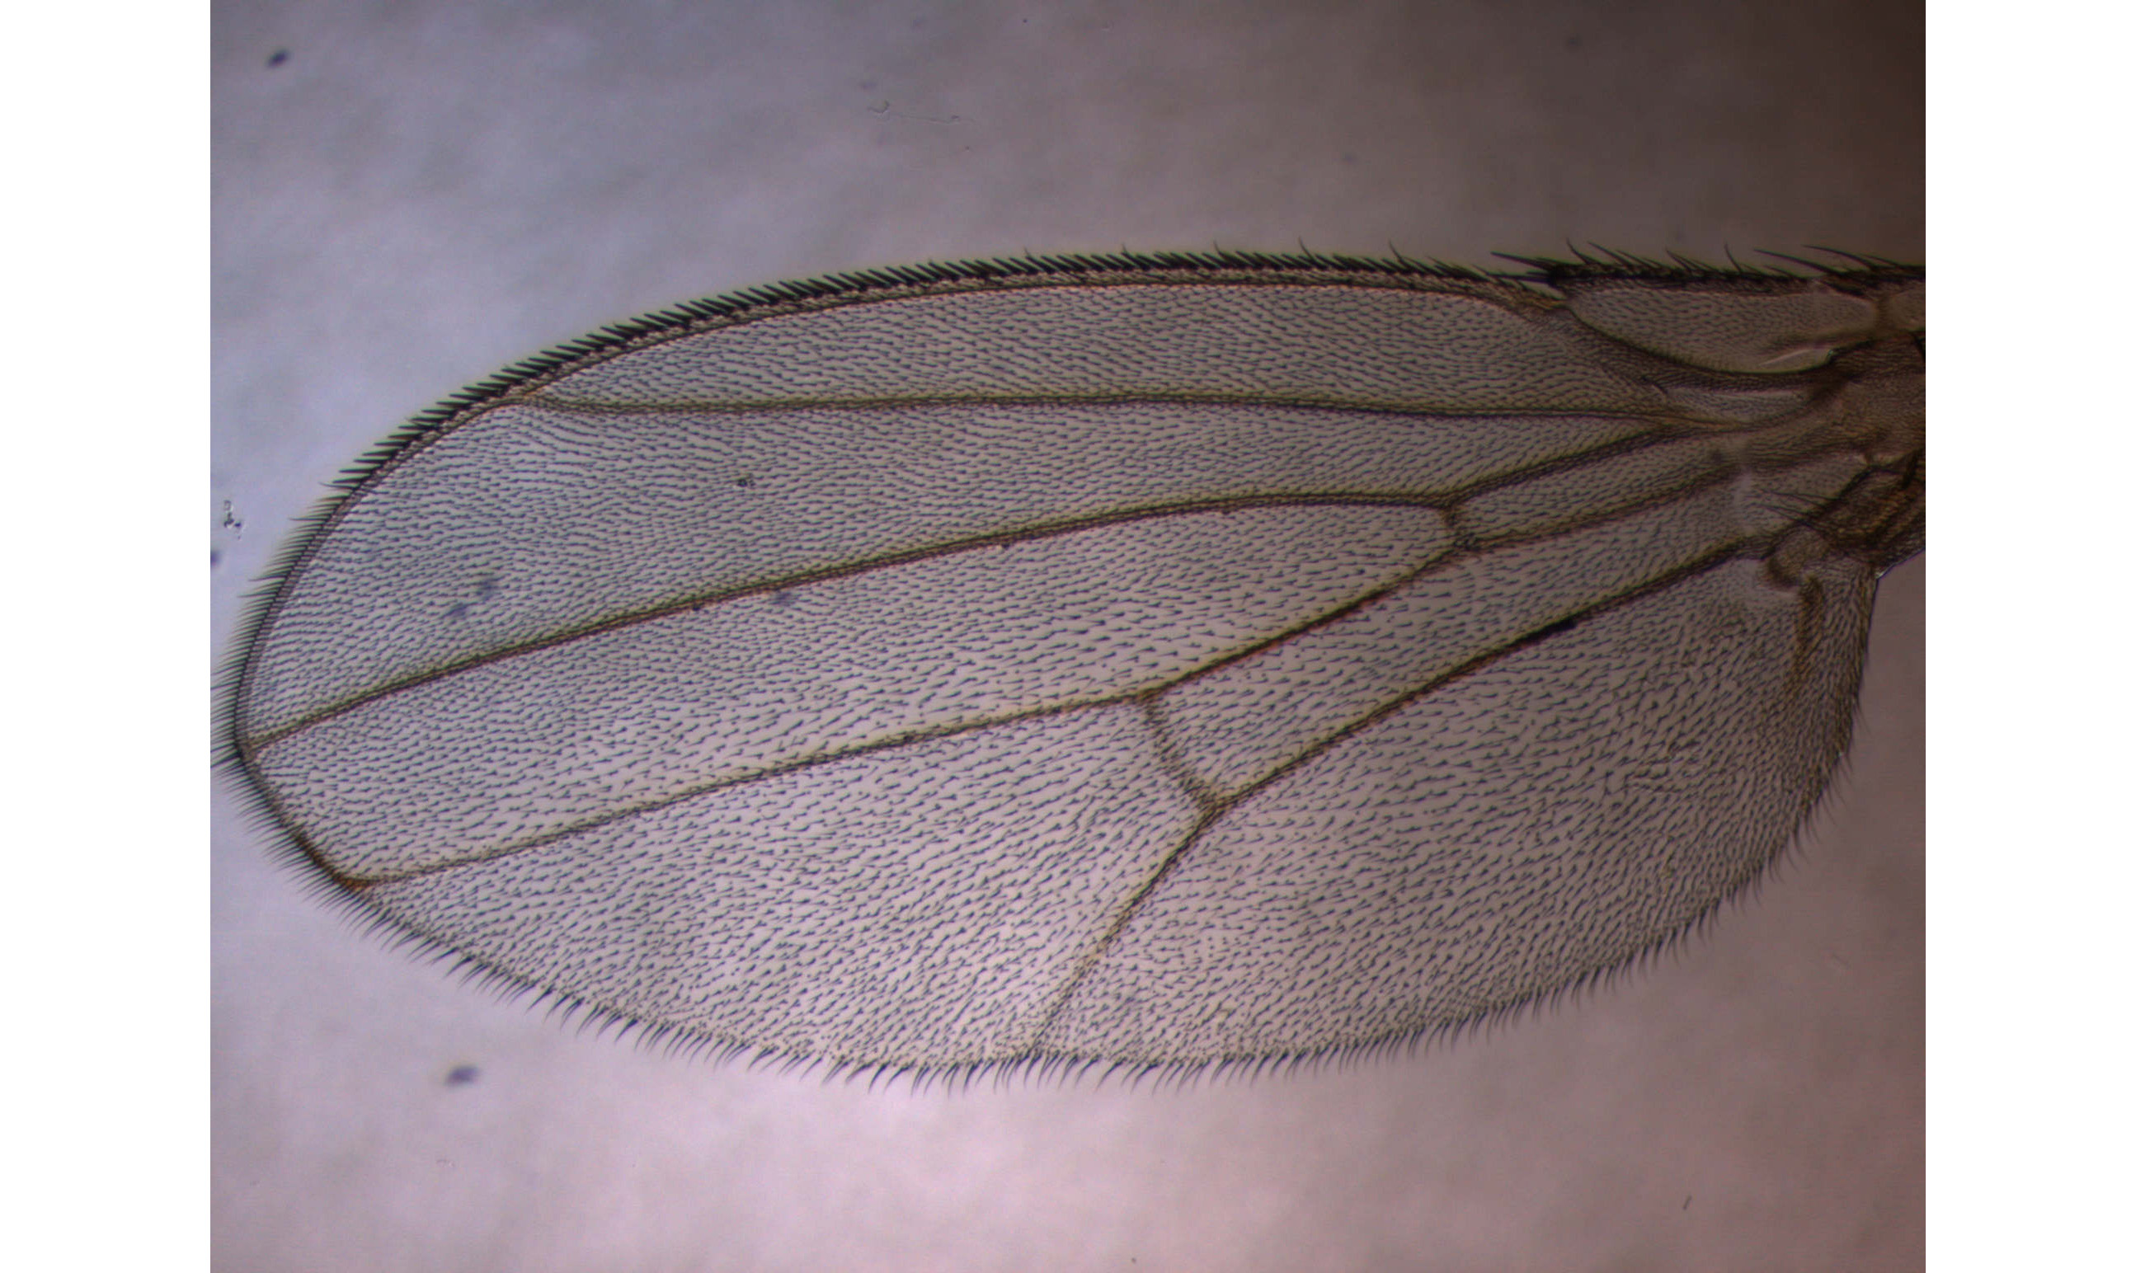
Fijiwings2.1: desktop
“Action Bar”
Fiji tools are still available
Dobens, unpublished

Slide 10
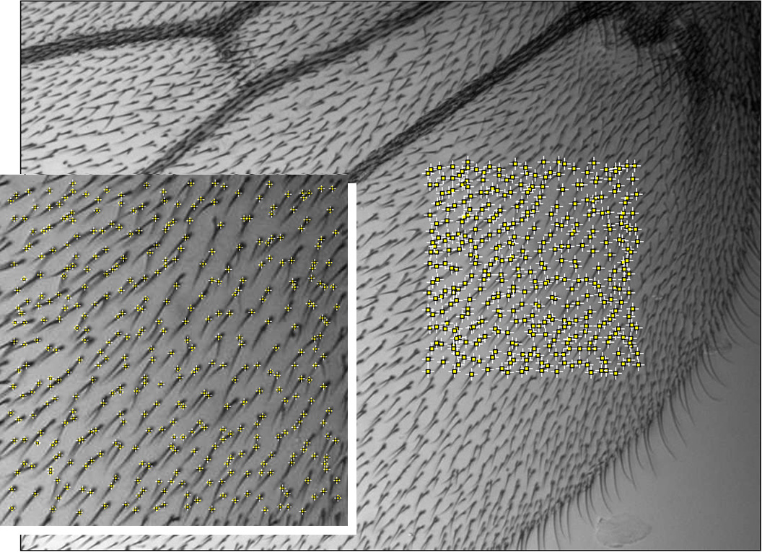
Using Fiji plug-ins to detect trichomes
‘detect local maxima’
Micrograph must be in focus, high contrast
Dobens, unpublished

Slide 11
Trichome identification
While precision 100%, accuracy 96%
Dobens, unpublished

Slide 12
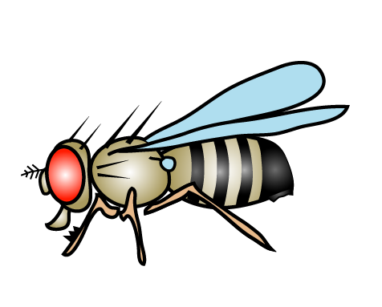
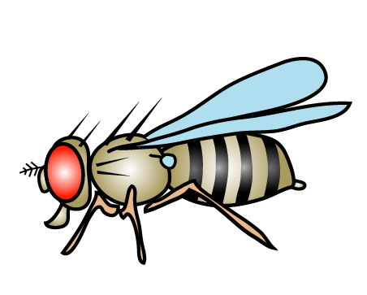
GAL4 misexpression system
X
Dobens, unpublished

Slide 13
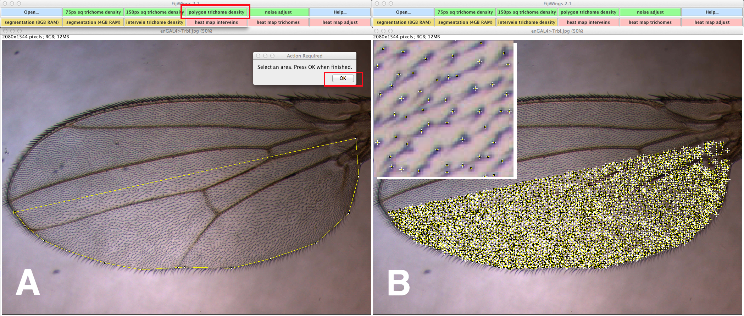
Fijiwings: ‘polygon trichome density’ tool
Dobens, unpublished

Slide 14
Segmentation
Dobens, unpublished

Slide 15
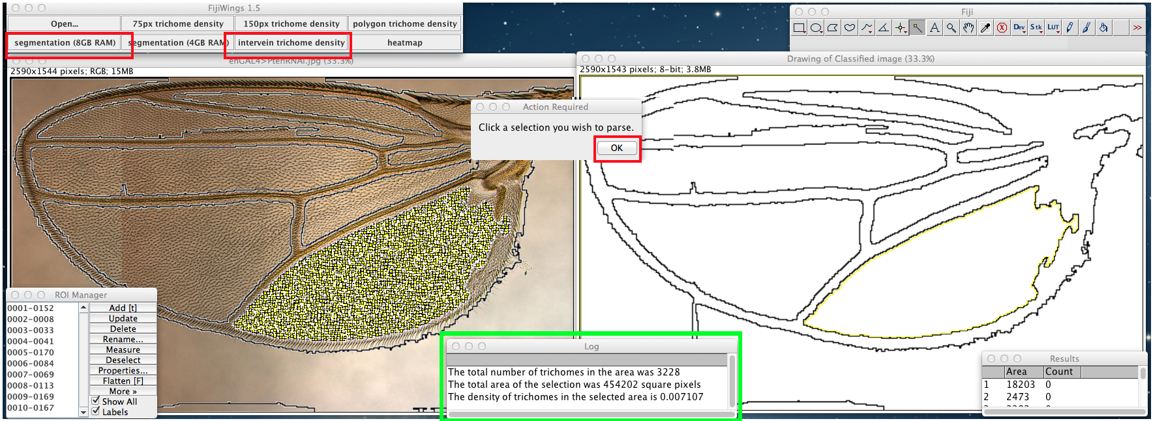
Intervein area and trichome density
Dobens, unpublished

Slide 16
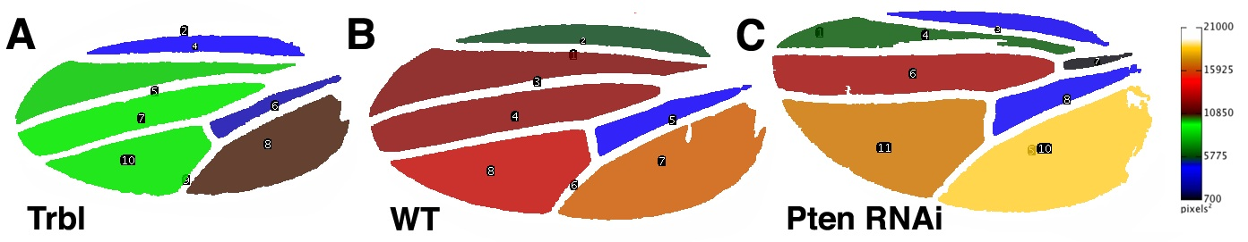
Heat map of tissue size
Dobens, unpublished

Slide 17
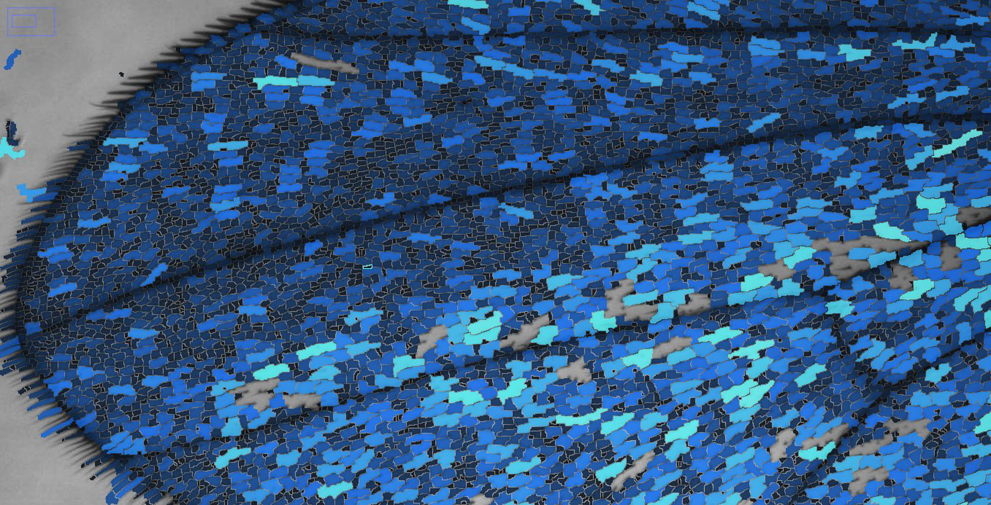
Identification of trichome density
Dobens, unpublished

Slide 18
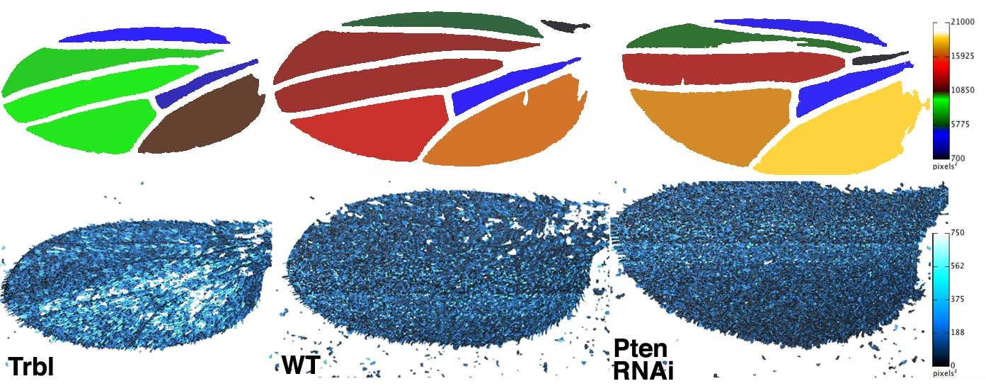
Size heat maps and trichome density cool maps
Available for download at sourceforge.net
Dobens, unpublished

Slide 19
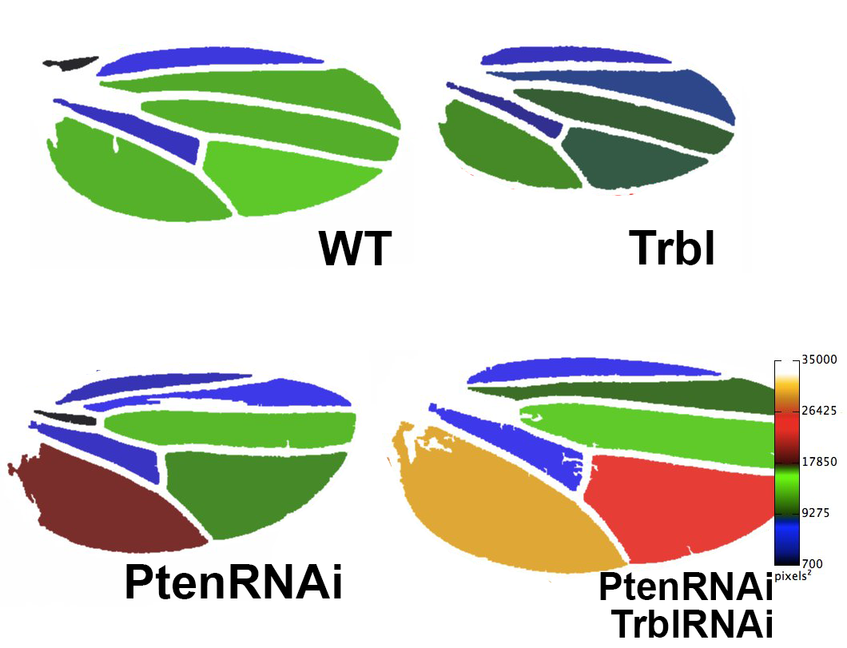
Trbl RNAi enhances PtenRNAi
Dobens, unpublished

